Slide 1


Data cleaning & standardisation in R
Laura Márquez
Salvador Fernández
September 27th, 2022
Notes:
Hello,
Welcome to the 3rd session of this Research data management workshop, brought to you by VLIZ and LifeWatch.
First of all, a big thank you for coming to this workshop and let’s start with the content.

Slide 2
What we will learn in this session
Importance of clean data
Intro to standards in biodiversity & its importance
Exercises!
Notes:
During this workshop we are going to learn on the importance of cleaning & standardizing the data in the field of science, we will have a short introduction to standards in biodiversity and we will get our hands on some exercises and learn a couple of functions in R useful to clean & standardize data.

Slide 3

FAIR principles
By Common Data Elements: Standardizing Data Collection (nih.gov)
Notes:
One of the major barriers to why researchers in the life sciences field don’t share their data is because of the daunting prospect of standardizing research data and the amount of work that it presents. However, if your data have a recognizable and common structure that includes formal terminologies to describe it, it wont be limited on how it can be used. Therefore, by standardizing your data and making it compatible and interoperable, you can contribute to the FAIR principles of data, making it more accessible to a higher number of people. And remember that you are not alone in this journey, there are institutions and organisms that can provide guidance and assist you to do it.

Slide 4
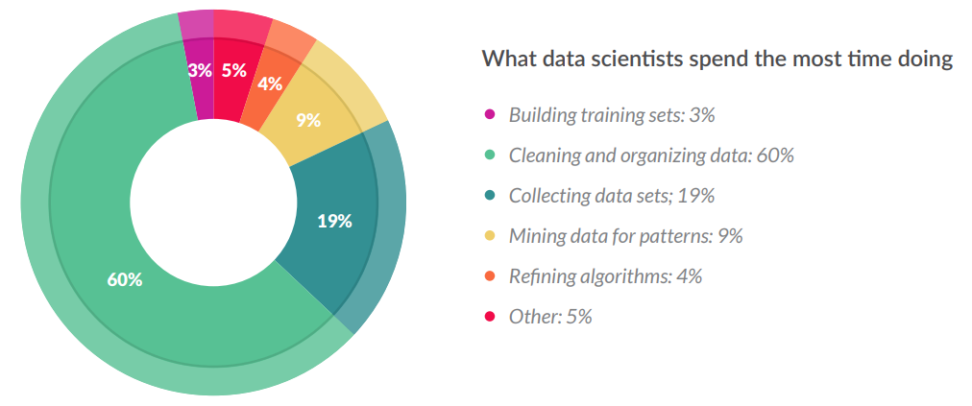
Most time goes to data wrangling
60% time cleaning & organizing!
CrowdFlower_DataScienceReport_2016
Notes:
Lets speak a little bit on the disadvantages of not wrangling our datasets. Let’s go to an example on how lacking data cleaning and organizing affects for example the data scientists. Generally, we think of data scientists building algorithms, exploring data, and doing predictive analysis. But that’s actually not what they spend most of their time doing. 3 out of every 5 data scientists actually spend most time cleaning and organizing data, up to 60% percent of the time. Messy data is by far the more time-consuming aspect of the typical data scientist’s work flow.

Slide 5
More on data cleaning time
“Students in PhD programmes spend up to 80% of their time on ‘data munging’, fixing formatting and minor mistakes to make data suitable for analysis — wasting time and talent.”
Invest 5% of research funds in ensuring data are reusable (nature.com)
Notes:
Now let’s consider for researchers. Of course, making sure that others can access data is firstly an ethical issue but not only that. If data are treated properly, researchers will have significantly more time to do research. Students in PhD programmes spend up to 80% of their time on ‘data munging’, For example, if you consider 400 students, that would amount to a monetary waste equivalent to the salaries of 200 full-time employees, at minimum. Instead, hiring 20 professional data stewards to cut time lost to data wrangling would boost a more effective research capacity. Many top universities are starting to see that the costs of not sharing data are significant and greater than the associated risks.

Slide 6
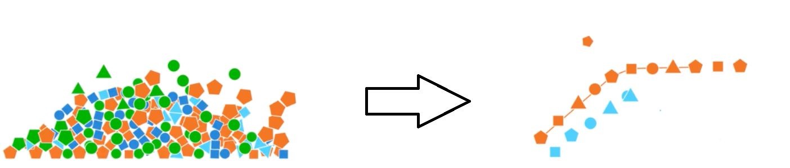
Data cleaning
Spell checking
Finding & replacing errors
Handling missing values
Merging and splitting columns
Joining tables
Tidy data
By ChrisJen517/ CCBY
Notes:
However, of course, it is not the case that you always have control over the format and the type of data you are dealing with….maybe you were not the person in the field or the lab creating it, and this is the case specially when you imported it from an external data source, such as a databases, text file, or a Web page. Because of that, it is so important that before analyzing the data or do anything with it, you check its scope and in several cases it will be needed be cleaned it up. Here you can find a short checklist on the actions to take to do data cleaning. READ THEM

Slide 7
Sources for this session
R binder Binder (mybinder.org)
Rstudio (library tidyverse installed)
Notes:
For this session we can make the use of binder, which is a source that allows to create an specific R environment, if you cannot handle your R session, you can make use of it

Slide 8
Tidy data
Quick reminders on tidy structure:
each column a variable
No colors, fonts, italics
id | name | age
No spaces or $peci@l characters
each row an
observation
Consistent names & good null values
Dates YYYY-mm-dd
Avoid using multiple chunks of data
Easy to read formats
INTEROPERABILITY
Notes:
Before starting let’s have a short review on tidy data…as a reminder TIDY data is a type of structure that helps us to make the data interoperable, making it much easier to analyze it later. You can see here a quick list of its characteristics: it has one column for each variable and only one row for one observation. The data has consistent names without special characters or spaces. It has good null values and does not use color coding or fonts, computers cannot read them. The dates are in the format starting with the year with 4 numbers Hyphen-minus month Hyphen-minus day. Finally, it avoids duplicated chunks of data & uses easy to read formats, such as csv.

Slide 9

Time for exercise!
Notes:
In the next part of this session, we will be working to clean and standardize this dataset…….lets go to our R session

Slide 10
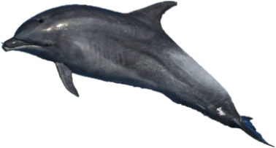
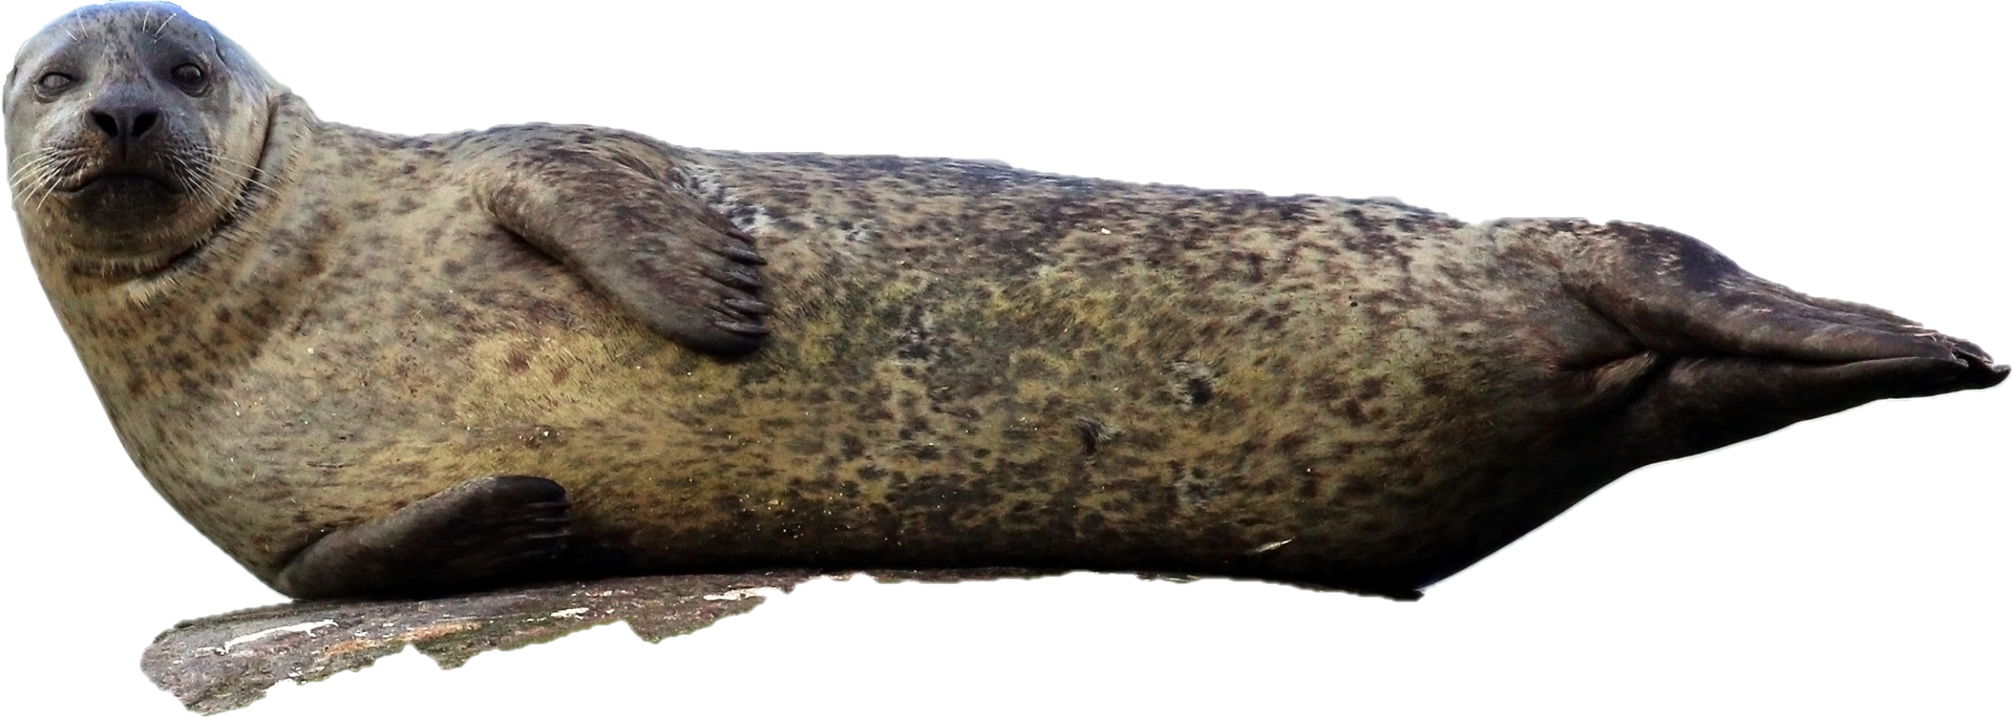
Exercise dataset
Derived from Laurent/ommag/ CCBY
Dataset title: Explore the shore example
Geographical coverage: Ireland
Parameters: Abundance
Taxonomic coverage: Mammalia
Citation: Fernández S.; Márquez L.; Flanders Marine Institute (VLIZ), Belgium; (2022): Explore the shore example. https://doi.org/10.xxxxx/xxx
Derived from Charles J. Sharp/ CCBY
Notes:
[3] Now that we got a short review in tidy data, let’s get hands on our exercises. Before starting its important to check the general scope of the dataset. Here we will be working with an example dataset, and the way to know more about it is to check its metadata: this is the WHAT, WHERE, WHEN, HOW, WHY and the WHO of the data. Here you can see some of the metadata so that you can easily tell what the dataset it about, a short reminder on the importance of the metadata. Could somebody help to tell us what it is about?

Slide 11
Time for exercise!
Notes:
In the next part of this session, we will be working to clean and standardize this dataset…….lets go to our R session

Slide 12
Exercises part A – 10 min
Open the file and look at the scope of the data, something strange with the site names? *use unique()
Identify mistyping errors in the site names and correct them *use str_replace()
Delete special characters and spaces from the data *use str_replace()

Slide 13
Key R functions to use in data standardisation
%>%
select()
filter()
mutate()
transmute()
Notes:
Here we are going to present some of the R functions that we use on a daily basis to do data management
First the pipe (%>%) Operator. This operator will forward the result of an expression, into the next expression. It is useful to avoid duplicate chunks of code. For instance, if we want to do different actions: filter, group it by categories, summarize it, and then order them, we could write it out in the same chunk of code.
# select – help us select specific columns
# filter which is useful to select specific rows
# mutate – which is to add columns to the dataframe
# transmute – that creates columns, but the result will be only those new columns in specific

Slide 14
Time for exercise!
Notes:
In the next part of this session, we will be working to clean and standardize this dataset…….lets go to our R session

Slide 15
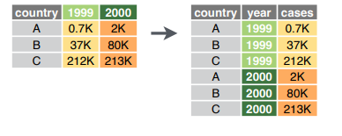
Exercises part B – 15 min
Standardize the dates in IS0 8601 standard (YYYY-mm-dd) *use separate() & mutate()
Use pivot function to get your data tidy (one observation per row) *use pivot_longer()
Drop the unnecessary columns *use select()
Notes:
Now that you know these functions, we will continue with the next part of exercises (B)

Slide 16
Recap
Data cleaning is key before handling, analyzing, etc.
Making your data TIDY is a great way to make data interoperable (and to share it with colleagues)
In R, tidyverse is a useful (collection) package to help you handling your data.
Upcoming…standardization in biodiversity!

Slide 17
Please install…
R packages mregions2 & worrms
#RUN
devtools::install_github("lifewatch/mregions2", build_vignettes = TRUE)
install.packages("worrms")

Slide 18
Lunch break
Notes:
In the next part of this session, we will be working to clean and standardize this dataset…….lets go to our R session

Slide 19
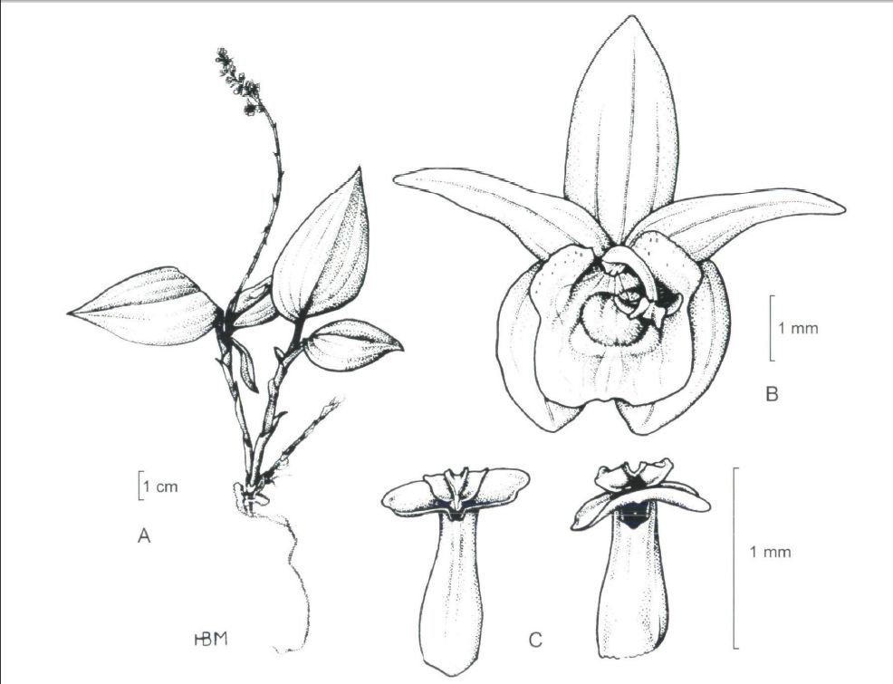
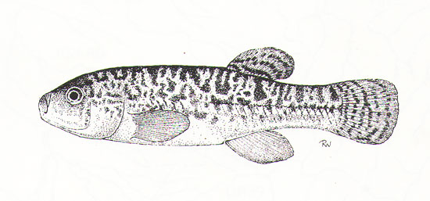
Standardisation
By S. Garman 1895
By Margonska and Szlachetko 2005
Orestias elegans
The World's Strangest Scientific Names| Smithsonian Magazine
Notes:
[3 min] After our lunch break, now we will check more into standardization. And we would like to start with this example where we have two different species with exactly the same name: Orestias elegans….one is a fish described by Garman in 1895 and the other is an orchid described by Ridl in 1888.
How to distinguish one from the other?
Of course this is an easy one to distinguish if you have the name of the authority who described it for example or you could infer it possibly from the type of taxa the sampling was about.

Slide 20
Standardisation
Derived from Laurent/ommag/ CCBY
Derived from Laurent/ommag/ CCBY
Tursiops truncantus Montagu, 1821
Tursiops truncantus (Montagu, 1821)
Notes:
[1 min] However, what happens when you have a case like this? It’s the same species name and the same authority…And both names were used in formal scientific publications.
What happened? What’s the difference?
Well, in this case, both names refer to the same species, however the one in your left has an unaccepted status, in this case due to the misspelling of the parenthesis. In case that you could have doubts for example, in the correct spelling of scientific names or if taxon is accepted or unaccepted, that can be easily checked when the data undergoes a standardization process.

Slide 21
Standardisation
“Standardization is critical to scientists and regulators to ensure the quality and interoperability of research processes…”
Standardization and Omics Science: Technical and Social Dimensions Are Inseparable and Demand Symmetrical Study - PMC (nih.gov)
Notes:
[3 min] Therefore standardization improves research because it increased the data quality, therefore improving the integration of data and its reusability, and of course facilitating the exchange of data with other partners. Not only that, but it is also allows the use of the data in software tools and, it even improves the team communication about it and could facilitates regulatory reviews. In general is not only important for to improve its interoperability but also to ensure its quality.

Slide 22
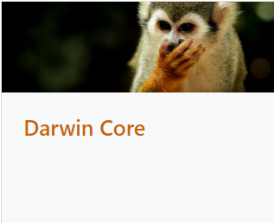

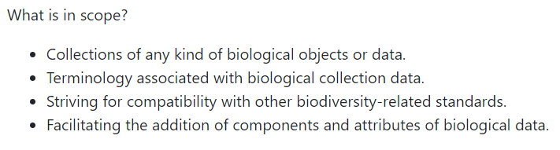
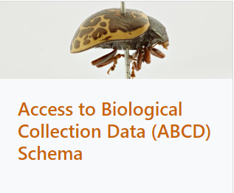
Standardisation
Standards in biodiversity
Darwin Core quick reference guide
Check many more standards Standards - TDWG
Notes:
[3 min] There are different standards in biodiversity. These standards were built according to the priorities of the use cases which they were designed for, it could be for example to compare and exchange data with each other without loss of information due to incompatible geographical boundaries (WGSRDP), to facilitate the sharing of information about biological diversity (Darwin Core), to represent tissue, DNA or RNA samples associated to specimens or collections (GGBNB), or for recording the relationship between a plant and a place (POSS).
Here we can see two of the most representative and widely used for collecting data & observations in biodiversity: Darwin Core which is useful to facilitate the sharing of information about biological diversity (Darwin Core), and ABCD that is a standard to access and exchange of data about specimens and observations.

Slide 23
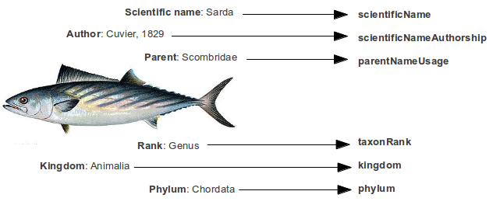
Standardisation
Standardizing the structure of the dataset: term names
Darwin Core quick reference guide
Notes:
[1 min] For the next exercise we are going to be using the Darwin Core standard, since it is one of the most widely used. I would like to remind you that the purpose is of this is to facilitate the sharing of information about biological diversity. Therefore, Darwin Core includes a glossary of terms aiming to facilitate the sharing of information about biological diversity. This by providing identifiers, labels, and definitions. Primarily it is based on taxa, their occurrence in nature documented by observations, specimens or samples, and its related information.

Slide 24
Standardization
1. Standardizing the structure of the dataset: normative term names
observationNumber
eventDate
date
Location
Latitude
decimalLatitude
Longitude
decimalLongitude
SiteName_clean
scientificName
Darwin Core quick reference guide
species
individualCount
abundance
recordNumber
Notes:
[5 min] During the next exercise we will be standardizing the general structure of the dataset. For this we will identify the normative term names for Darwin Core (a.k.a. the name of the columns) that we would use according to the Darwin Core Standards. The exercise will be to take the original name of the column of our dataset DataAbundance and try to match them with the correct Darwin Core column name. Could someone help us with any example?

Slide 25
Exercises part C – 5 min
Modify DataAbundancew column names to fit the Darwin Core column names * use rename()
Notes:
[5 min] Now that we have clear what is the structure of the dataset, in R we are going to modify our example dataset to have the correct column names

Slide 26


Data standardisation
2. Standardizing data points: taxonomic quality control & georeferenced standards
Notes:
[1 min] OK and apart from standardizing the general structure so that we could share it with others, we can also standardize some of the information of the data points. Just like in the general structure, there are different types of standardization that you could apply. For example, you could standardize the name of the species, the geographical locations of your dataset and even the stuff that you measured from them.

Slide 27


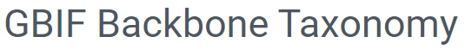


Data standardization: Taxonomic quality control
To check more authorities: GBIF Backbone Taxonomy
Notes:
[2 min] The first type of standardization we will be applying to the observation points is the taxonomic standardization. To standardize the species names, there are different authorities that you can consult to accurately manage the names of the taxa you are working with….There are different lists depending on the taxa or the type of data that you are dealing with. For example, if them are marine, if they are vascular plants, flies, DNA, fossils or more. You can check more authorities on the link at the bottom of the slide. Some of them are more widely used than others.
Apart from these authoritative lists, there are also integrated backbones that include names from different authorities to integrate the information from different resources, for example the GBIF Bakcbone taxonomy, that integrate all GBIF species in a single list.

Slide 28
Data standardization: Taxonomic quality control
LSID
WoRMS -Tursiops truncatus (Montagu, 1821)
Tursiops truncatus
Notes:
[2 min] In this example, because we are working with marine data, we will be using WoRMS to standardize the names of the species. WoRMS stands for the World Register of Marine Species (WoRMS) and is the main authority on marine species. It provides a comprehensive list of valid names of marine organisms, including its synonymy….WoRMS uses APHIA, which is the name of the database in which all the WoRMS data are stored. In this database, each species is linked to an ID and also to a Life Sciences Identifier (LSID), which is a globally unique persistent identifier, this is an common way to name and identifying data resources across many sources, making them interoperable…and every taxa has its own unique LSID.
[An LSID is a A Uniform Resource Name (URN) useful to store information permanently, it contains what it is (urn:lsid), the issuing authority, the name and the ID]

Slide 29
Time for exercise!
Notes:
In the next part of this session, we will be working to clean and standardize this dataset…….lets go to our R session

Slide 30
Exercises part D: taxon quality control – 10 min
Use worrms library to obtain the LSID of each species and put them in a new column named “scientificNameID”
* use wm_records_taxamatch (make sure to check the outcome of the search)
* once you obtained them, use “do.call(rbind, myspeciestable)” to transform the tibble to data frame
* use left_join to ONLY add the LSID
Notes:
In this exercise we will be using the worrms package to search and obtain the LIFE SCIENCES IDENTIFIER LSID of the species and include them in a new column named scientificNameID

Slide 31
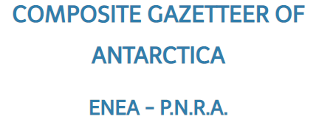

Data standardization: Geographical standards
Marine Regions
ICSM Composite Gazetteer of Australia
Place Names (fsdf.org.au)
GeoNames
Notes:
Now we will speak about geographical standards. Geographic Information Systems have become indispensable tools in managing and displaying data and information. For standardization, we have different tools available for georeferencing different parts of the world, for example the ICSM composite Gazetteer for Australia an online application available for users to access place name information from Australia and its’ External Territories, GeoNames geographical database, which covers all countries or for example Marine Regions which covers different marine areas, seas, sandbanks, ridges, bays and others.

Slide 32
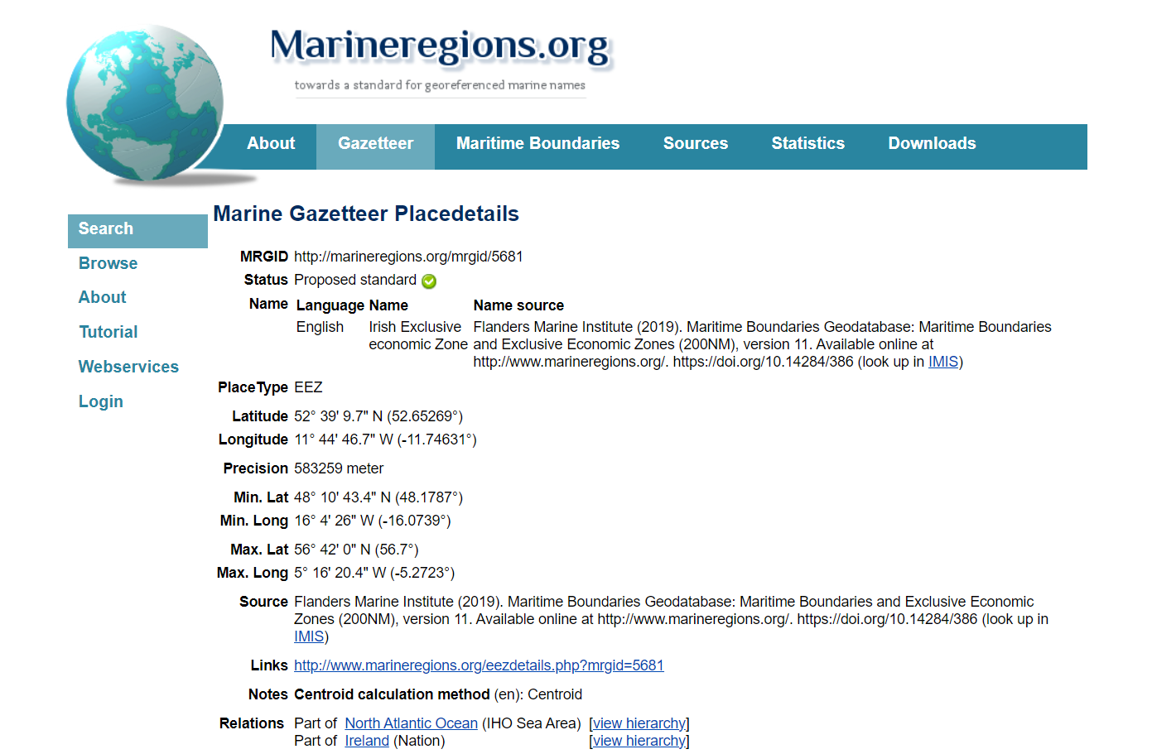
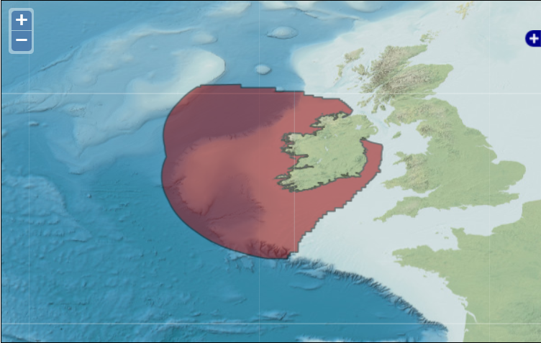
Data standardization: Marine georeferencing
Marine regions Gazeetter
MarineRegions R client (github.com)
Notes:
For this standardization exercise, we will be using the tool Marine regions, available for georeferencing different parts of the world, of course mainly marine regions, but not limited to it. Marine Regions is a standard and relational list of geographic names. It contains information and maps of the geographic location of these features. You can do a search using our gazetteer or in the future also through the R package marine regions, at the moment you can use our current version by accessing the marine regions github.

Slide 33
Time for exercise!

Slide 34
Exercises part E: Marine georeferencing – 10 min
Use mregions2 to search for the correct id of the region (make sure to check the outcome of the search) and put it in a new column (locationID) * use mr_gaz_records_by_name & use the EEZ of Ireland
Notes:
For our last exercise we will be using marineregions to search for the correct id of the region and add a new column to our dataset. This column name will be “locationID”. Since this exercise is a bit more complicated we will give you an extra line of code for you complete the exercise.

Slide 35
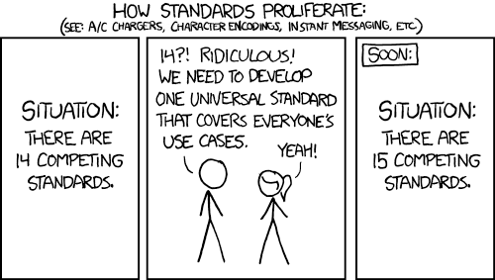
Yes, many standards…
By xkcd/ CCBY
Notes:
I know I know, just like this comic shows (read it), it could seem as if there are so many multiple standards that they seem to be competing with each other.

Slide 36
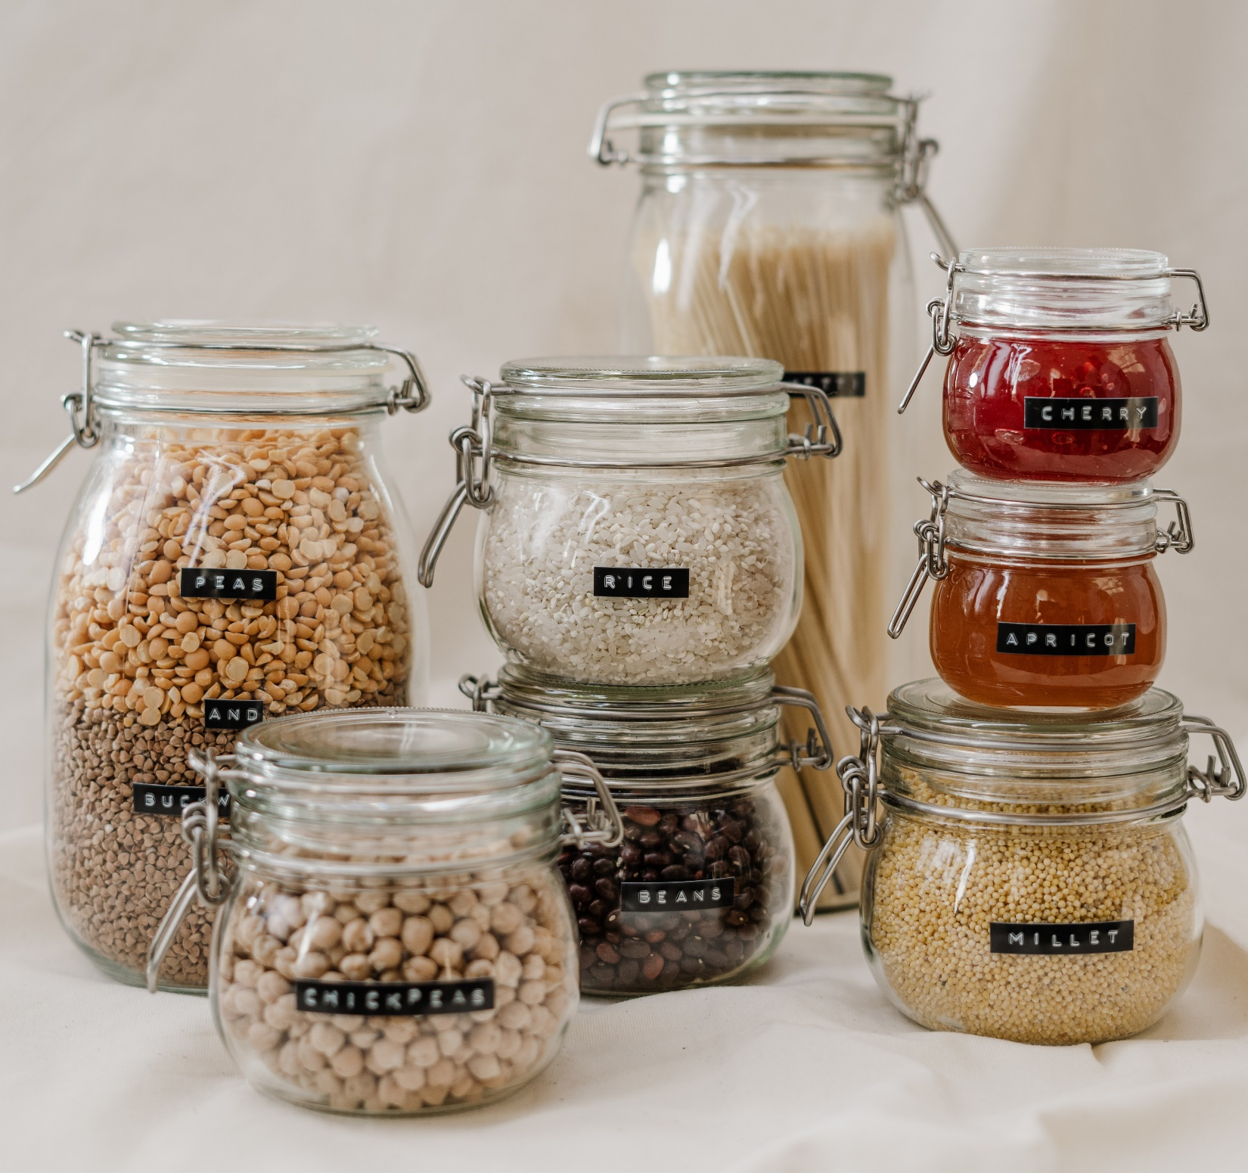
They work as containers where you can fit in your data!
DARWIN CORE
ABCD
WGSRPD
AUDUBON CORE
TAPIR
WGSRPD
GUID
your data
his data
her data
their data
Derived from Glass Jars With Food/ CC
Notes:
But the beauty of them is that they are broad, just like data is. Remember that there are many many different types of data and that is the reason why there are so many types of standards, to fit in YOUR data. Standards work like empty containers, where the emptiness is what makes them useful, to fit different data.

Slide 37
Summary
Data cleaning is an essential before handling, analyzing, etc., using R makes it easier
Making your data “tidy” is a great way to make data interoperable (and to share it with colleagues)
In R, tidyverse is a (collection of) package to help you handling data.
In biodiversity, there are different standards useful for sharing your data, such as Darwin Core or marine regions.
Standards are helpful to make sure we are all in the same page!

Slide 38
Further reading
www.lifewatch.be www.marinespecies.org www.marineregions.org Course: Contributing datasets to EMODnet Biology Best Practices in Publishing Species Checklists :: GBIF IPT User Manual The OBIS manual
Introduction to rgbif • rgbif (ropensci.org)

Slide 39
THANKS!

Slide 40


For further questions you can contact us:
Salvador Fernández
salvador.fernandez@vliz.be
Laura Márquez
laura.marquez@vliz.be

